Slide 1

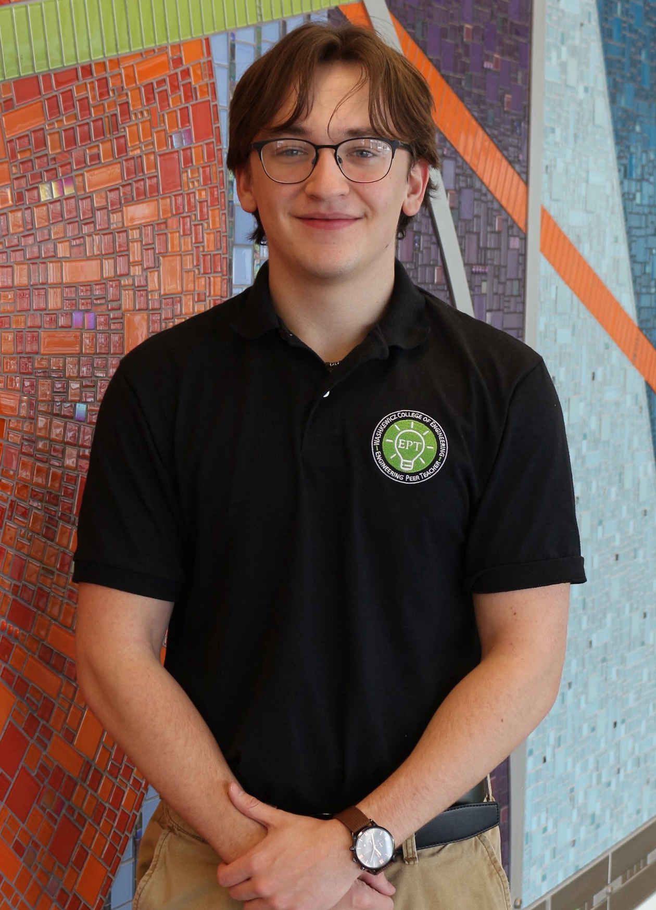
Engineering Portfolio
ABOUT ME
Mathew Jackson
Junior Mechanical Engineering Student (Class of 2028)
Cleveland State University – GPA: 3.94
Cell: (330) 390-5955
Email: m.mrjackson@vikes.csuohio.edu
LinkedIn: www.linkedin.com/in/mathew-jackson-b91940295
Interested In: Manufacturing Engineering, Engineering Design, Project Management
Work/Leadership Experience:
- Great Lakes Construction Company | Co-Op (Summer ‘26)
- Lead Engineering Peer Teacher | Statics & Fluid Mechanics (Spring ’26-present)
- Rooted in Faith Life Group at CSU | President (Fall ‘25-present)
SKILLS
SOLIDWORKS, MATLAB, Microsoft Office, Engineering Drawing Comprehension, Leadership, Machining, Teaching, Collaboration

Slide 2
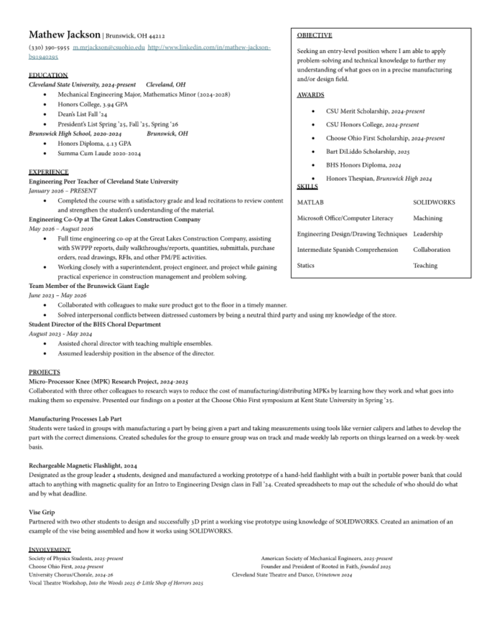

Slide 3

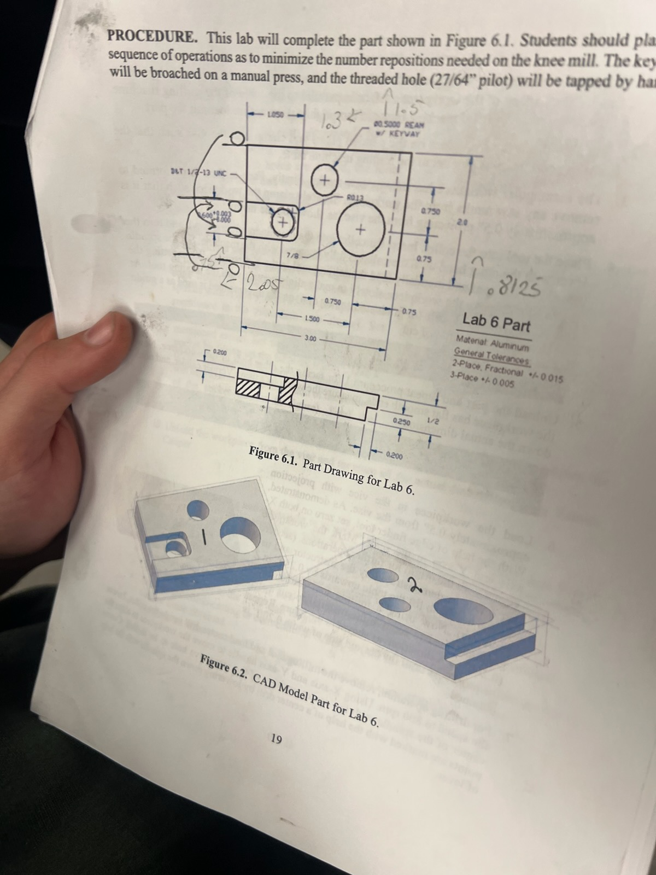
MACHINED Aluminum Block
(Fall ‘25)
PROJECT OVERVIEW:
We were placed into groups of 5-6 to machine an aluminum block into the desired size with the requested modifications (3 holes, 1 slot, 1 ledge)
CHALLENGES:
We were given a strict time constraint of around 2 months in class with only 1 class per week (about 8 classes total).
Colleague accidentally pressed block in too tightly and created a deformation from the chuck.
RESULTS:
We were able to get through these challenges by strategically planning out and communicating who would do what to ensure we used all of our time appropriately. The chuck bite was able to be machined down a bit where the slot was, with the only visible deformation being a slight nick on the corner.
Post-machining, we realized our hole dimensions were not completely accurate to the drawing. Going forward, I would not only zero the coordinates at the corner of the part, but I’d also measure distances and drawing where the center of each hole would go before drilling.

Slide 4
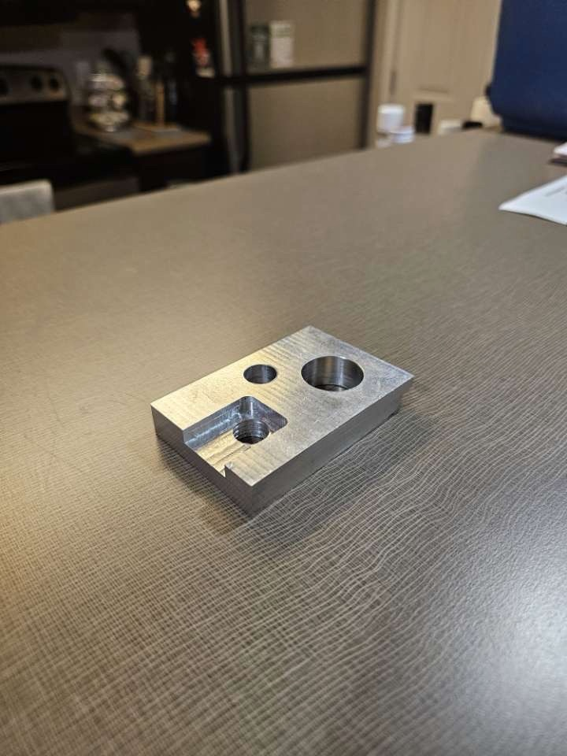
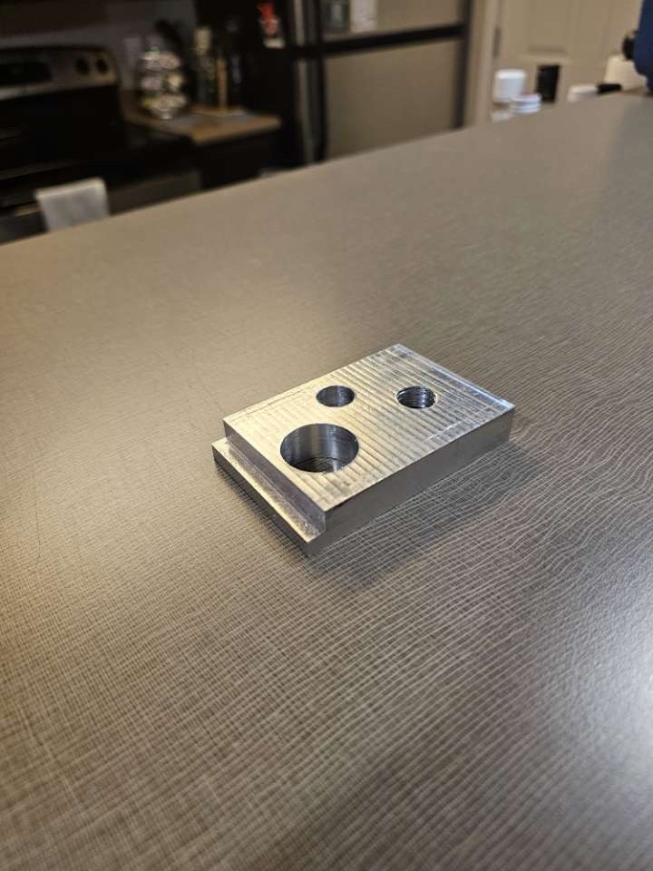
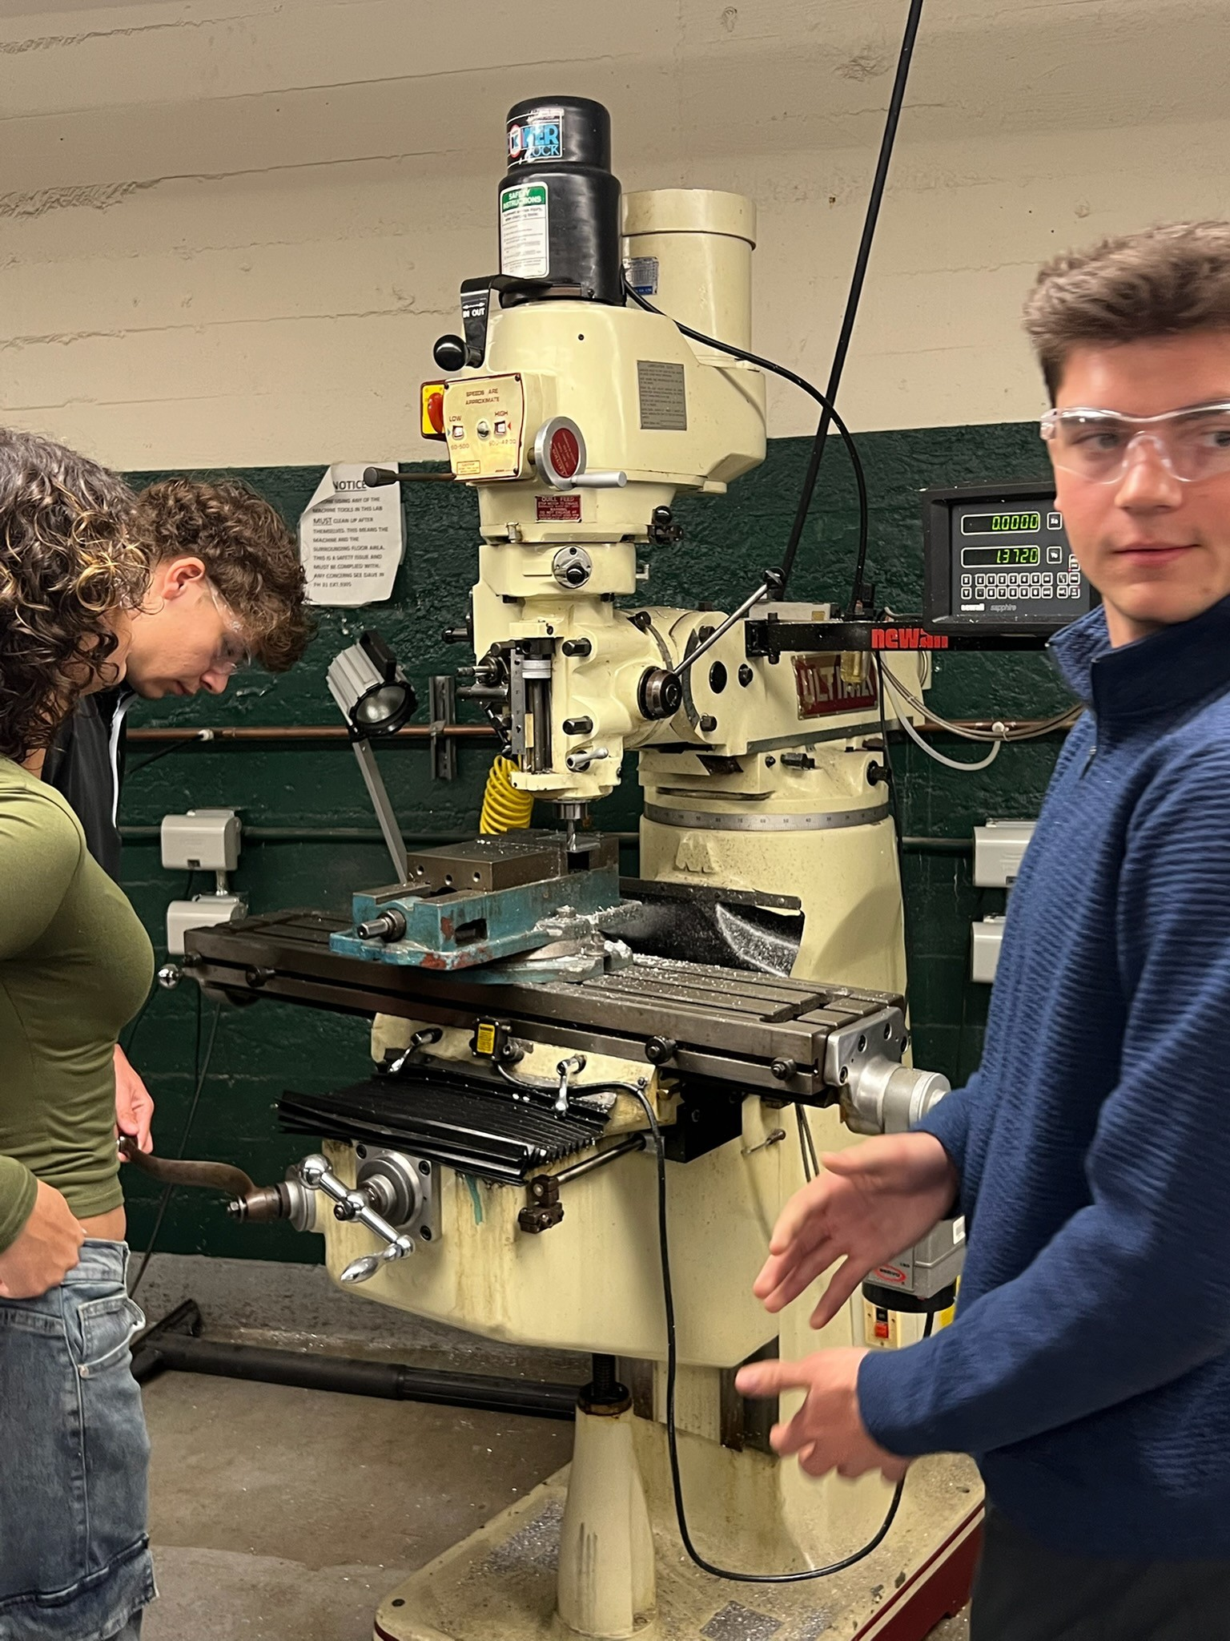

Slide 5
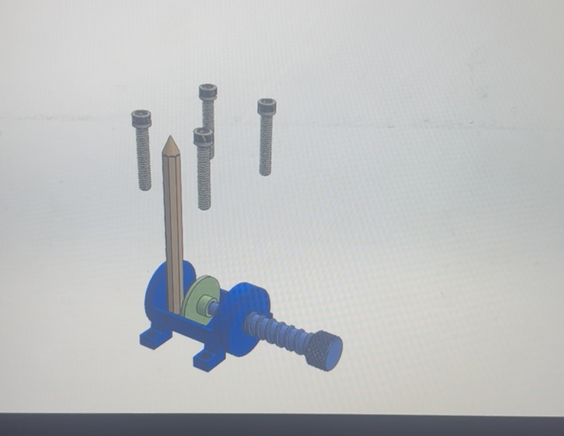
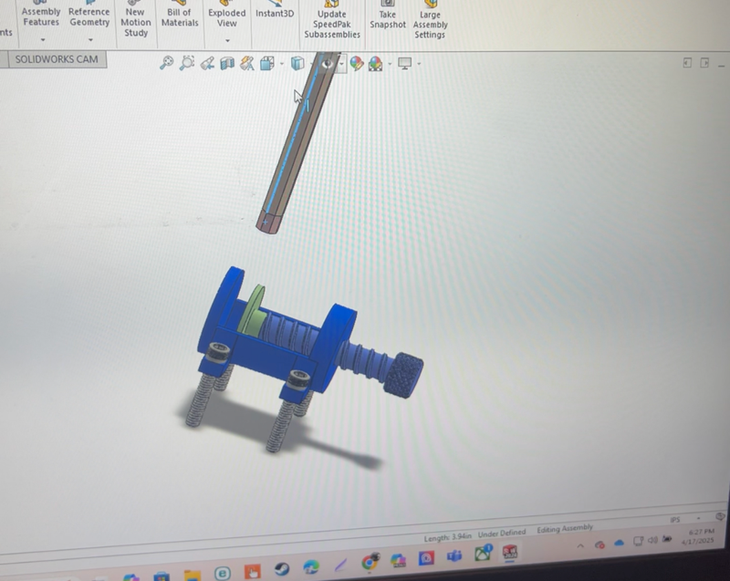
Vise Grip
(Fall ‘25)
PROJECT OVERVIEW:
We were placed into teams of 3 and tasked with designing and 3D printing a functional vise to hold a pencil.
CHALLENGES:
We were given no other instruction or outline other than to create the vise and an animation.
Time constraint.
Pencil could still rotate within the vice.
RESULTS:
We were able to successfully complete and print a working vise by dividing the work up into manageable chunks.
One of my teammates had his own 3D printer which was very beneficial for this project as we were able to print multiple times and stop progress early if we noticed it failing.
We noticed that the pencil was able to rotate in the vise when moderate torque was applied. Going forward, I would personally fix the flat jaw geometry problem by using something like a 90 degree V-groove so there’d be more contact regions or adding a thin rubber pad inside to increase friction.

Slide 6
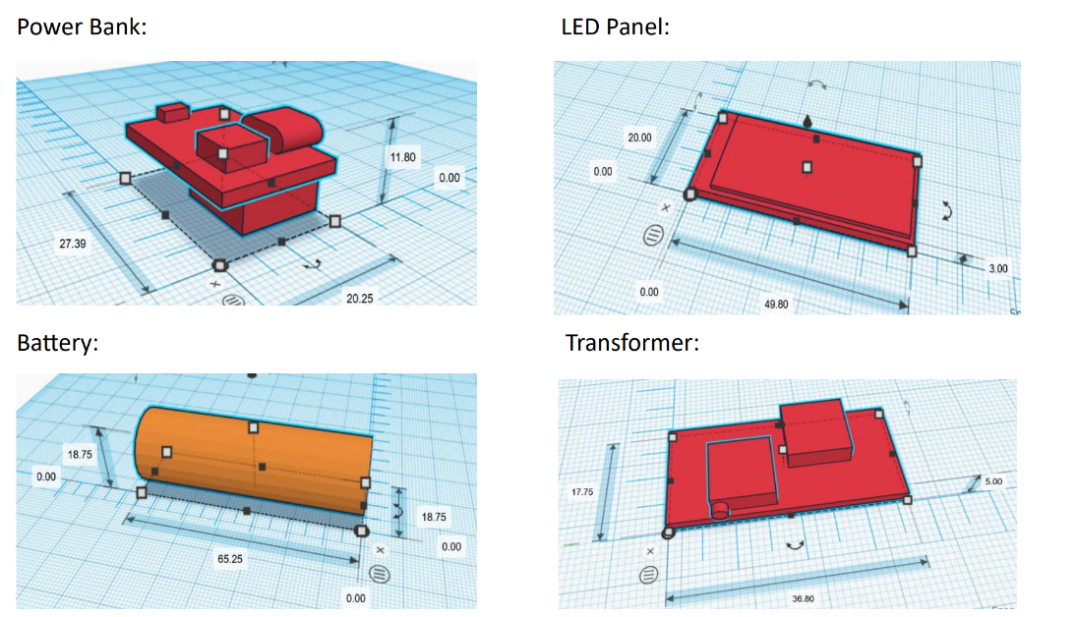
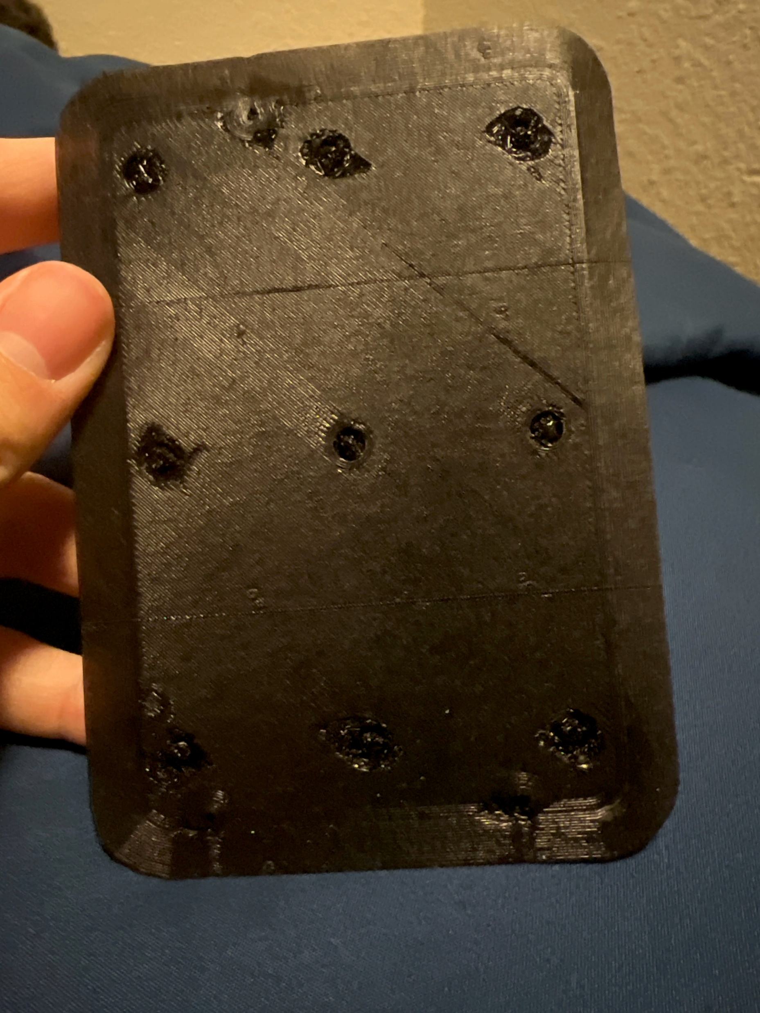
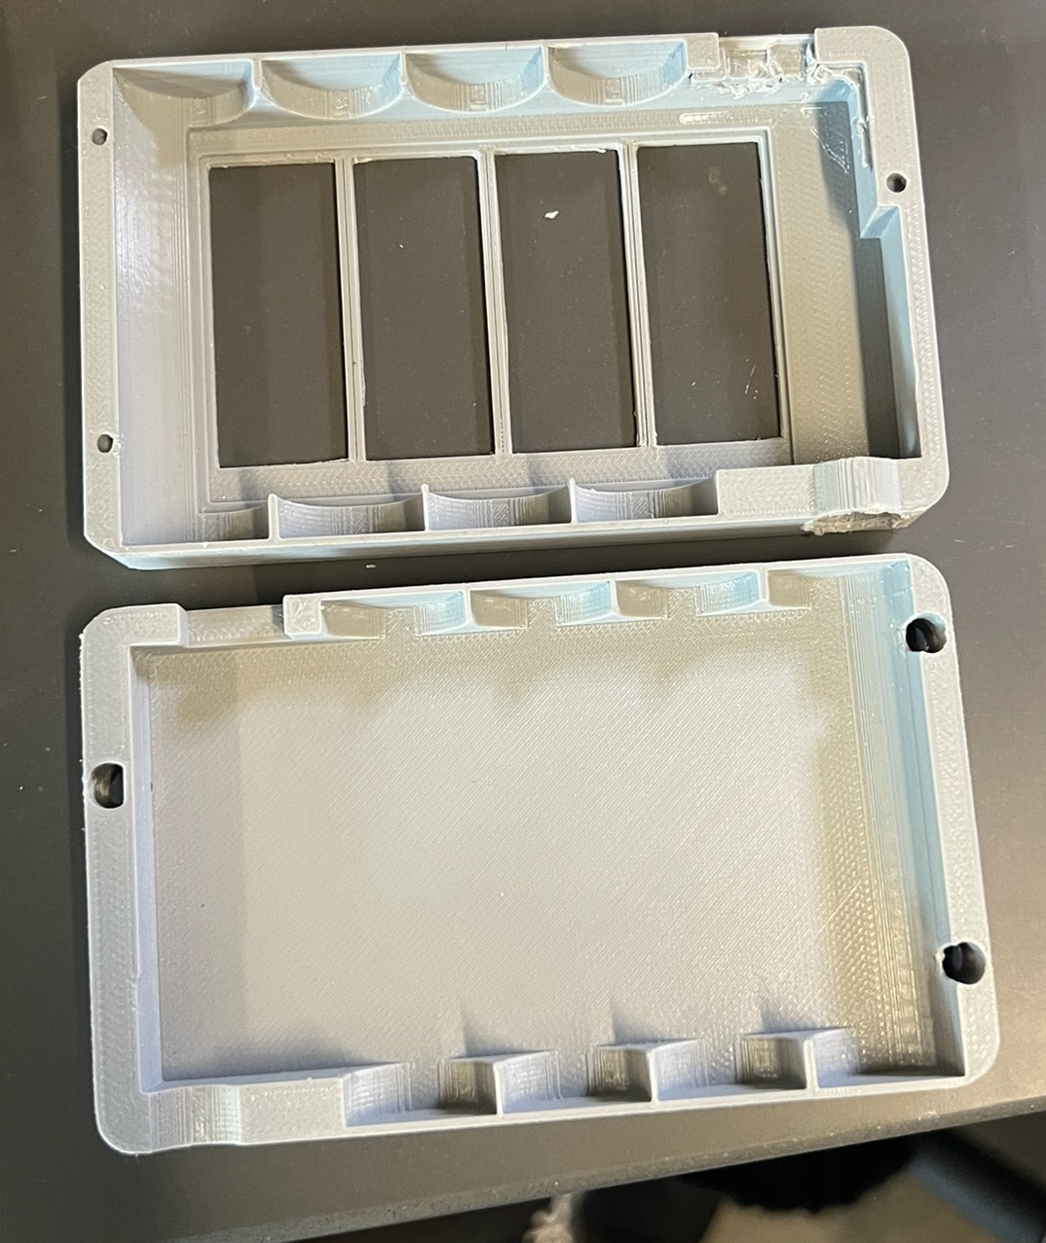
Magnetic Rechargeable Flashlight
(Fall ’24)
PROJECT OVERVIEW:
Our goal was to come up with, design, and manufacture a product to present to our class. Our group decided to create a rechargeable, portable flashlight that was magnetic. I was assigned the role of “Group Leader”.
CHALLENGES:
Fitting all of the components in a hand-held device
Manufacturing the holes of the magnets
Uncooperative group member
RESULTS:
Using TinkerCAD, we were able to successfully dimension each component of the flashlight and design a case to hold everything that fit perfectly. The holes for the magnets kept being filled with material runoff, but we were able to clean them out for our final design. Additionally, we had a group member who rarely showed up to class, which put us down a member and putting more work on everyone else. I was able to successfully reach out to the person to find a solution, which led us to be able to create a schedule and get things back on track.

Slide 7
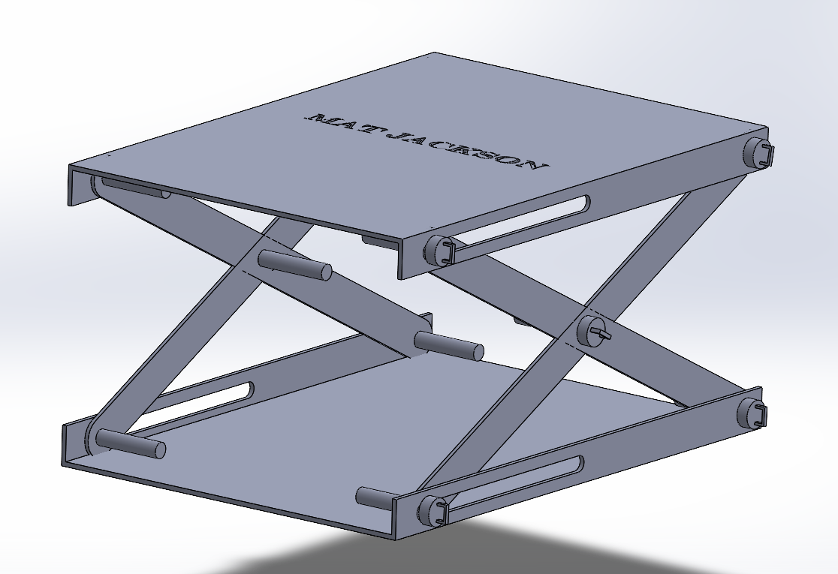
Scissor Lift
(Summer ‘26)
PROJECT OVERVIEW:
My goal was to design and model a compact scissor lift platform with the goal of exploring mechanical design with the limits of constrained motion. The project focused on creating a stable lifting mechanism using a pair of crossed links and guide slots to achieve smooth vertical motion while maintaining platform alignment.
CHALLENGES:
Motion constraints while maintaining stability.
Clearance between part components
RESULTS:
I used SOLIDWORKS to make this simple design. Using only two links per side, the lift can now support vertical extension while maintaining a parallel plate alignment. As for the clearance of the scissor arms, I found that they pass very close to each other while being used. I went through a few different linkage designs to prevent interference between the arms, pins, and sheet metal flanges throughout its full range of motion.
If I were to further the development of the sign, I would consider alternative cross-section designs or material removal to optimize weight. Possibly bearings or bushings to reduce friction at pivot points. I would also consider some sort of locking feature for improved safety while in us. I could also add a hydraulic/motor lift system as well to optimize it.

Slide 8
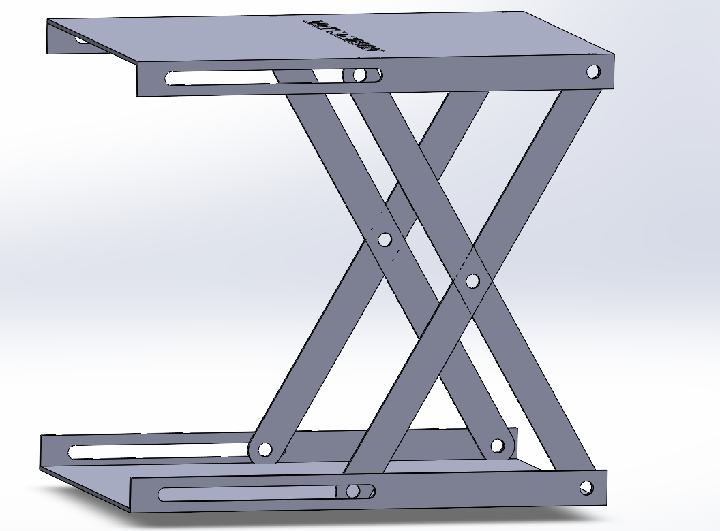
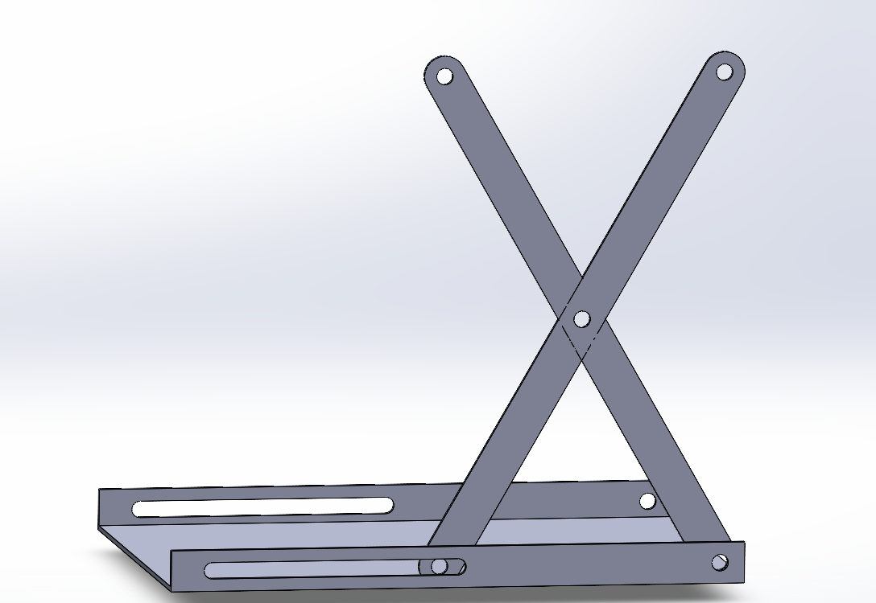

Slide 9
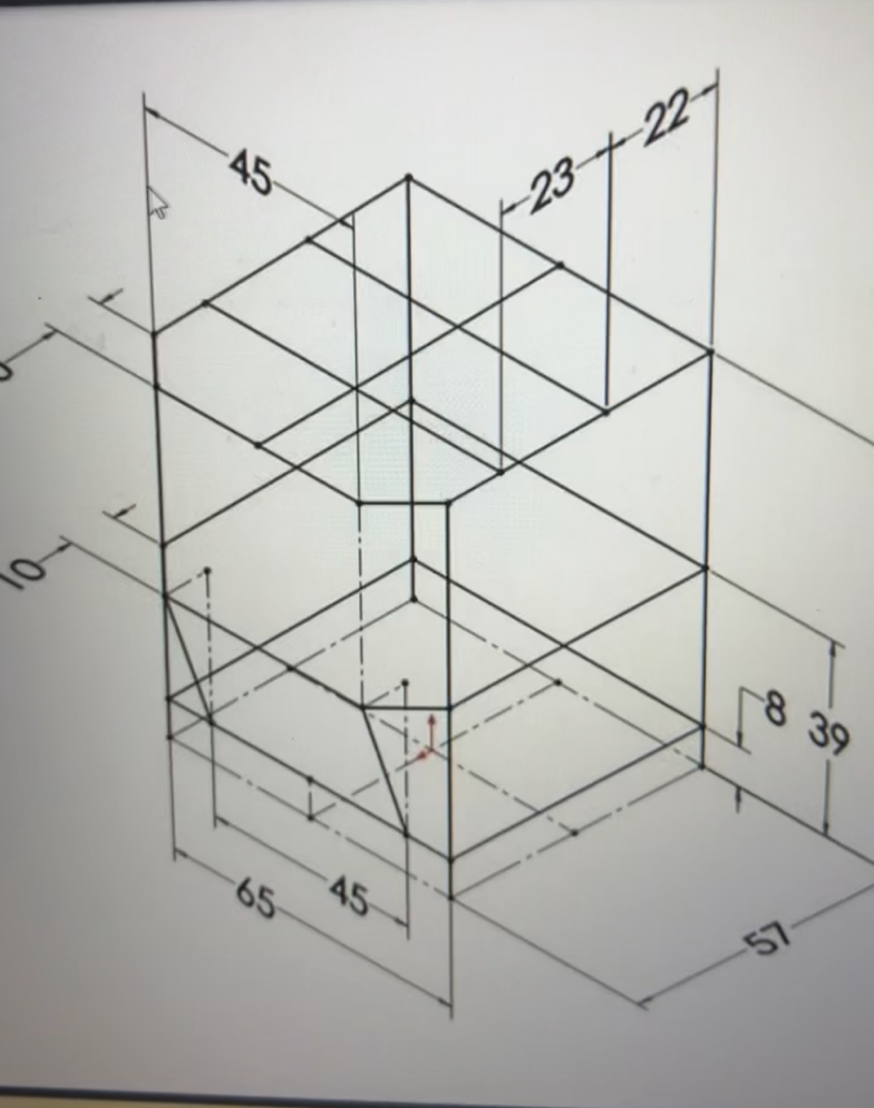
Assembly
+
Welding Special Parts
(Spring ‘25)
PROJECT OVERVIEW:
We were asked to all individually study a dimensioned assembly and perfectly recreate it as one of our assignments.
CHALLENGES:
Having no groupmates would be challenging as I’d have no one to share work with.
Assembly included welded parts, which required additional work to show.
RESULTS:
I was able to complete the project by working away at it piece by piece every day as I had to also balance work from other courses.
Mating some of the parts at the dimensioning of it proved to challenging as some of the dimensions were slightly ambiguous, but I was able to figure those out and the special welding pieces by consulting our professor and a few friends in the class.

Slide 10
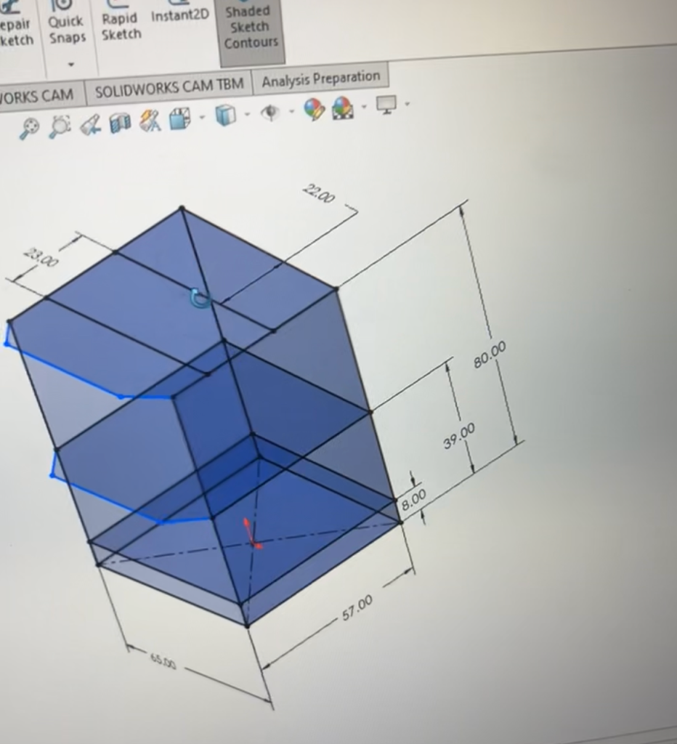
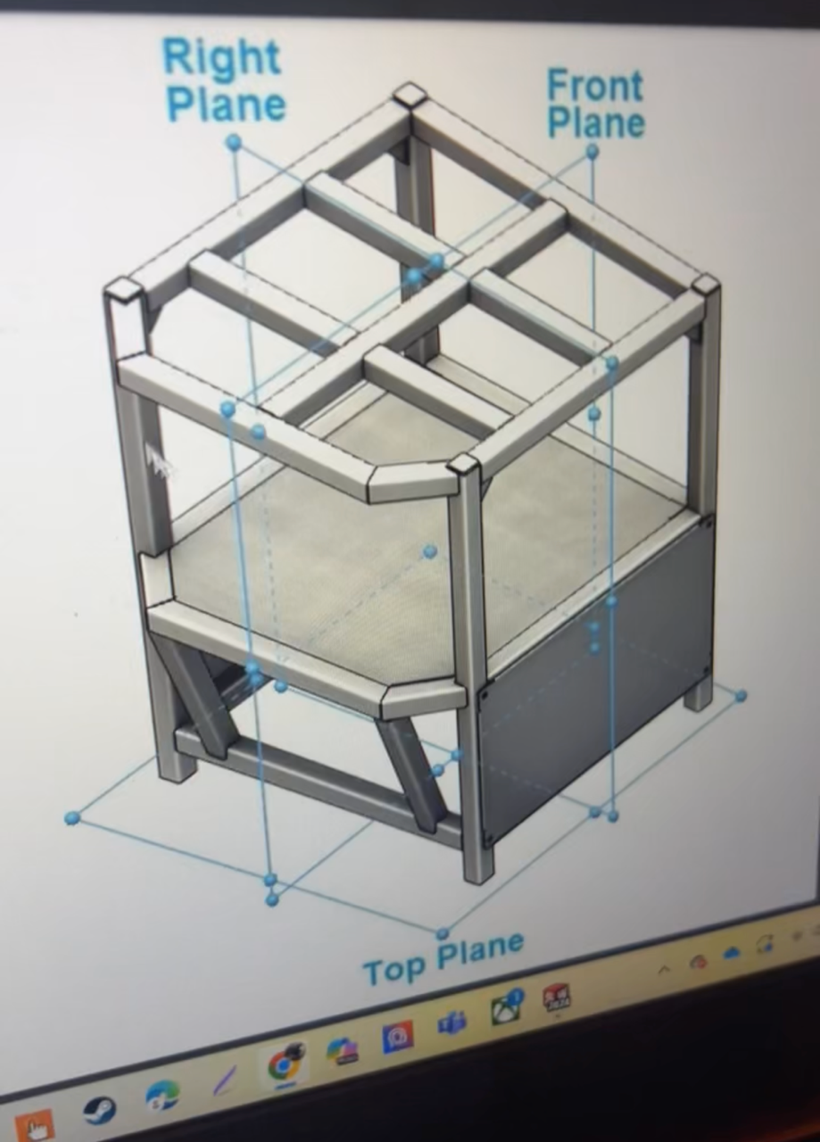

Slide 11
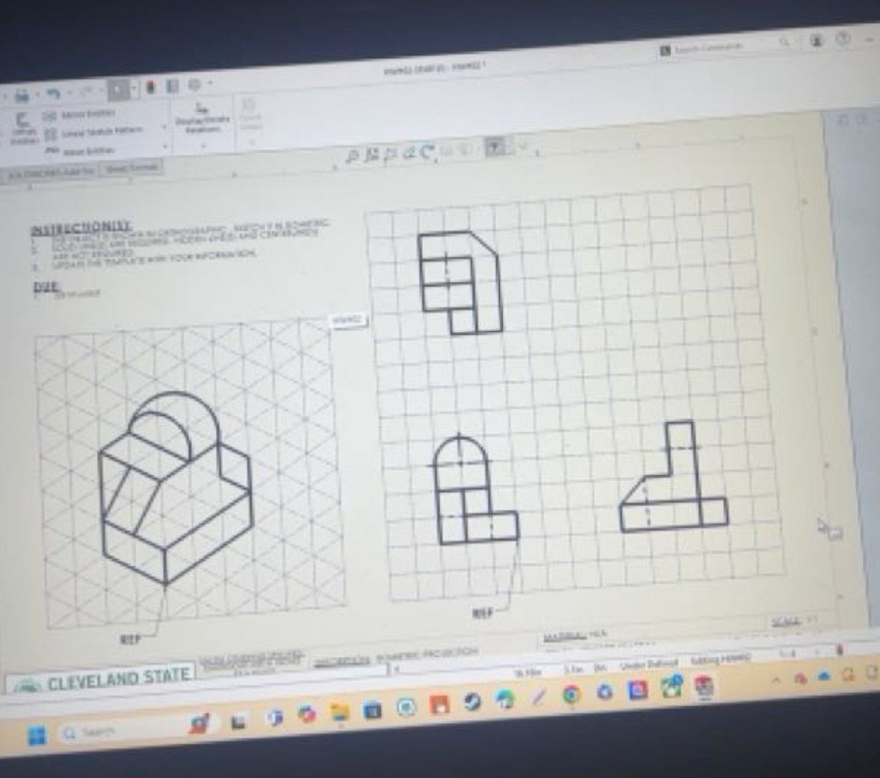
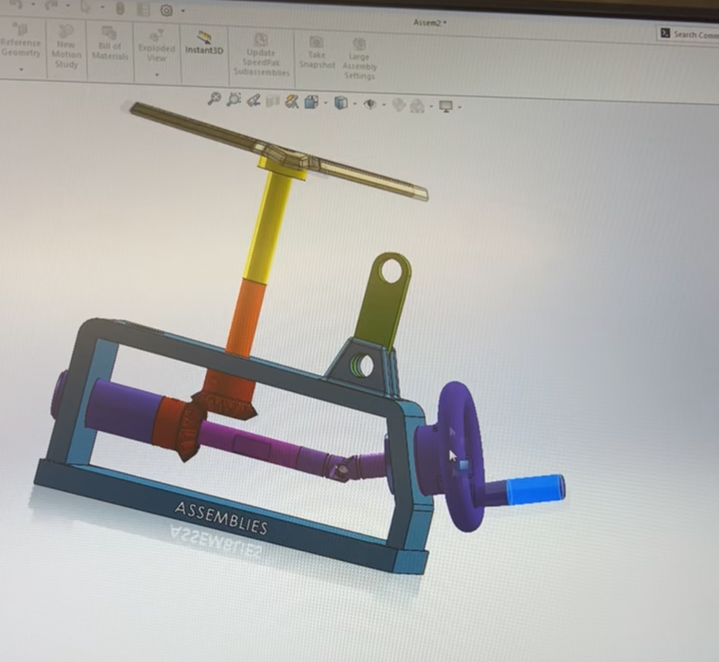
Isometric Views
+
Assembly Mating
(Fall ’24 - Spring ’25)
As apart of our Computer Aided Engineering courses, we learned the introduction to analyzing geometric views and converting them to isometric, and vice versa.
To the left is one of our first examples of it, where we were provided the main image (left) and then had to draw each side of it (right).
We also learned how to download parts from a toolbox and input them into SOLIDWORKS to create an assembly, where we would then mate and link them together to create a working machine.
To the right is a contraption we made from individual parts to spin a wheel and make a propeller spin.

Slide 12
